Slide 1

Sentimental Analysis
By A.A

Slide 2
Introduction
Many companies focused on reducing environmental impact and carbon footprints want to understand public perception of climate change. This insight would help them gauge how their eco-friendly products and services might be received, enhancing their market research efforts.
In this context, we have received a dataset sourced from Twitter, pertaining to climate change.
Problem Statement: Building a deep learning model to classify whether people believe in climate change based on their tweets, in order to improve and tailor customer-based products.
Each tweet is labelled as one of the following classes:
2: News(the tweet links to factual news about climate change)
1: Believer(the tweet supports the belief of man-made climate change)
0: Neutral(the tweet neither supports nor refutes the belief of man-made climate change)
-1: Agnostic(the tweet does not believe in man-made climate change)

Slide 3
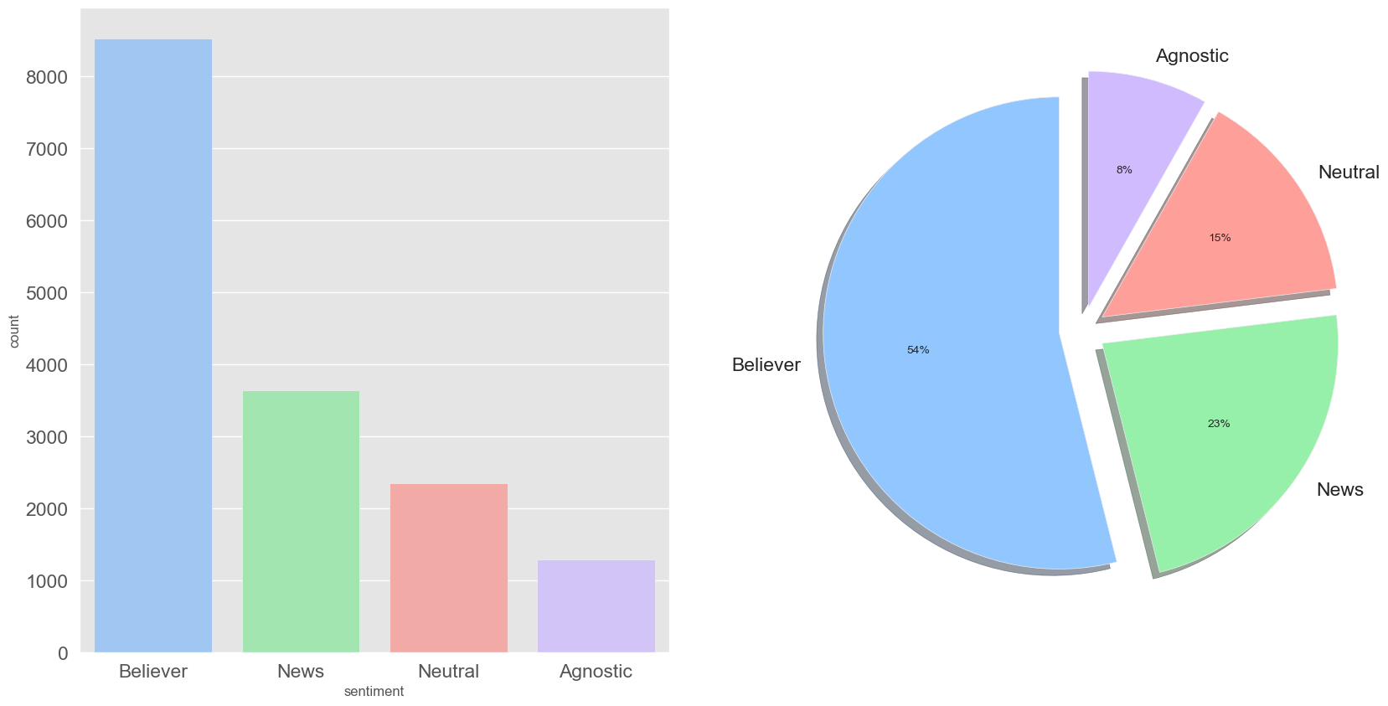
Distribution of Sentiment

Slide 4
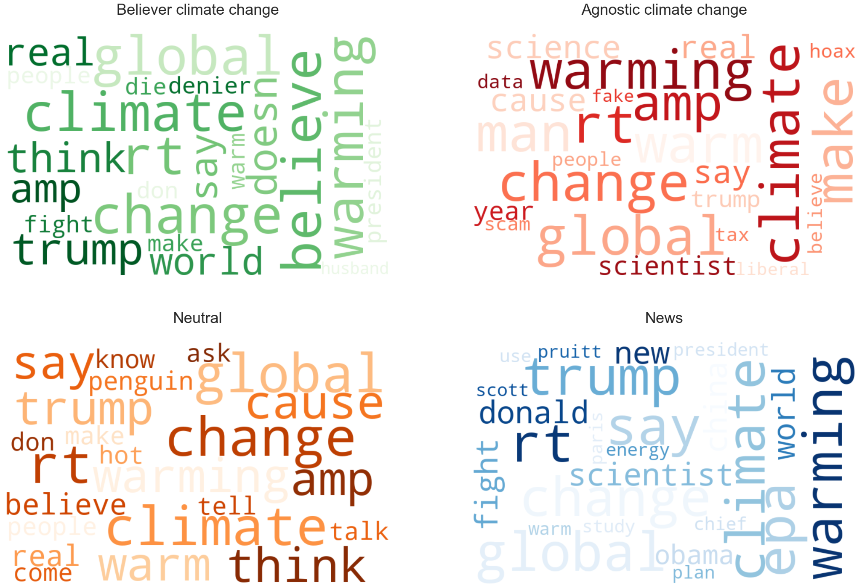
Word Count for Sentiments

Slide 5
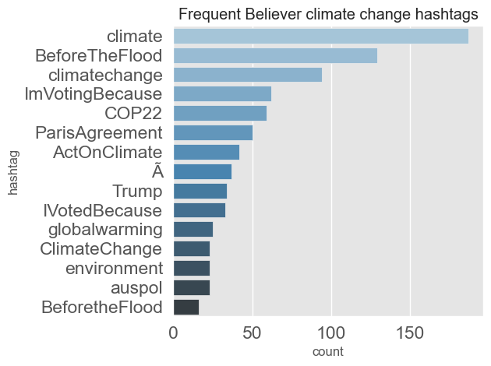
Frequent Believer Climate Change Hashtags

Slide 6
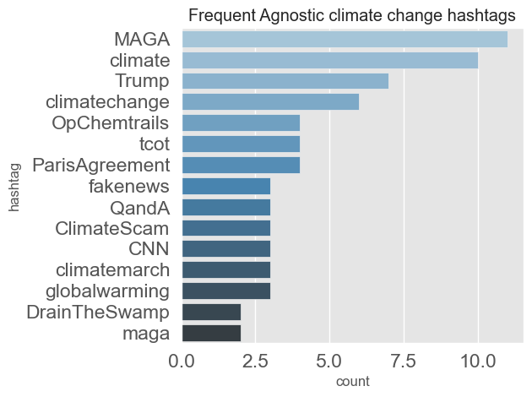
Frequent Agnostic Climate Change Hashtags

Slide 7
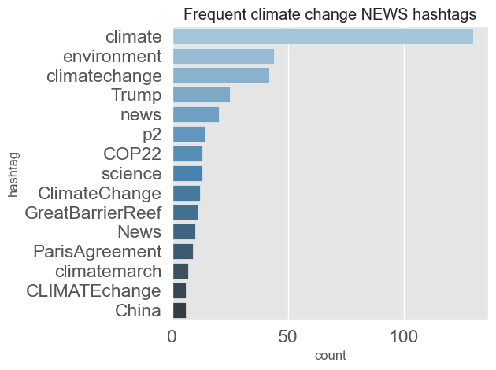
Frequent Climate Change News Hashtags

Slide 8
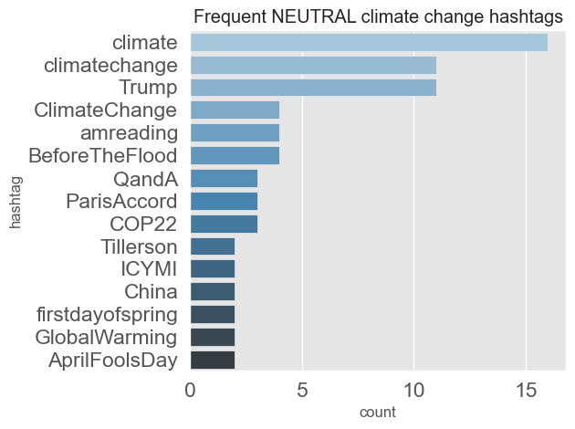
Frequent Neutral Climate Change Hashtags

Slide 9
Conclusion
Sentiment analysis has strong commercial interest because companies want to know how their products are being perceived and also prospective consumers want to know what existing users think.
More than half of the tweets examined support the belief of man-made climate change

